Slide 1
IPv6 Introduction
Joe zhao
SW2
Great China R&D Center
ZyXEL Communications, Inc

Slide 2
Outline
IPv4 limitations
IPv6 advantages
IPv4 vs IPv6
IPv6 terminology
Training course arrangement
Appendix
Q & A

Slide 3
IPv4 limitations
Shortage of IP address
  IPv4, 32bits allows for 4,294,967,296 addresses
  More and more devices (cell phone, PDA etc…) will consume IP address
Routing performance
  About 85,000 routes in the routing tables of Internet backbone routers today.
  The current IPv4 Internet routing infrastructure is a combination of both flat and hierarchical routing
Configuration
  Manually configured
  Need a stateful address configuration protocol such as (DHCP)
  Wait a full minute before abandoning DHCP configuration and self-configuring a IP address

Slide 4
IPv4 limitations
IP header constrain
  Optional field is limited, only 40 bytes
Security
  IPsec is optional for IPv4
  Proprietary security solutions are prevalent
QoS
  Relay on TOS filed and the identification of the payload
  TOS(8 bits) field has limited functionality and, over time, has been redefined and locally interpreted.
  Additionally, payload identification that uses a TCP or UDP port is not possible when the IPv4 packet payload is encrypted

Slide 5
IPv4 limitations
NAT implementation
  Performance (translation bottleneck)
    Maintain NAT table
    IP & port translation must be performed on each package
    Modify checksum in IP header
  Peer-to-peer limitation
    Cannot talk with peer behind NAT directly
    Need to configure NAT equipments to mapping corresponding service
    Need additional operation in NAT equipments or application
  A makeshift measure to extend the life of the IPv4 public address space
    It isn’t a solution to the IPv4 public address space problem.

Slide 6
IPv6 advantages
Large address space
  128-bits (16-bytes). over 3.4 x 10^38 possible combinations
  Support multiple levels of subneting and address allocation
Efficient and Hierarchical Addressing and Routing Infrastructure
  Efficient and hierarchical addressing and routing infrastructure (backbone & individual subnet)
  Backbone routers have much smaller routing tables
Notes:
Global unicast address to satisfy ISPs tier requirement

Slide 7
IPv6 advantages
Simple configuration
  Manually configured
  Stateful configuration ( from IPv6 DHCP server)
  Automatically configure themselves with link-local addresses without DHCP server
  Link-local addresses are auto-configured within one second
  Communication with neighboring nodes on the link is possible immediately
Built-in security
  Must support IPsec internally
  Provides a standards-based solution for network security needs and promotes interoperability between different IPv6 implementations
Notes:
Even in the absence of a router, hosts on the same link can automatically configure themselves with link- local addresses and communicate without manual configuration. Link-local addresses are auto-configured within one second and communication with neighboring nodes on the link is possible immediately. In comparison, an IPv4 host using DHCP must wait a full minute before abandoning DHCP configuration and self-configuring an IPv4 address. (169.254.0.0/16)

Slide 8
IPv6 advantages
New header format
  Move nonessential and optional fields (checksum etc…)
  Support extension header behind IP header
  Flexible extensibility for different application
  IPv6 header is more efficiently processed at intermediate routers
Better support for QoS
  A filed in IP header to indicate the traffic class
  A Flow Label field in the IPv6 header allows routers to identify and provide special handling for packets that belong to a flow .
  The traffic is identified in the IPv6 header, so QoS can be achieved even when the packet payload is encrypted

Slide 9
IPv6 advantages
New protocol for neighboring node interaction
  ICMPv6 messages that manages the interaction of neighboring nodes (nodes on the same link)
  Replace ARP (broadcast-based) & ICMPv4 Router Discovery & ICMPv4 Redirect messages with multicast and unicast Neighbor Discovery messages

Slide 10
IPv4 vs IPv6
Feature IPv4 IPv6
Address length 32 bits 128 bits
IPSec support Optional Required
QoS support Some Better
Fragmentation Hosts and routers Hosts only
Packet size 576 bytes 1280 bytes
Checksum in header Yes No
Options in header Yes No
Link-layer address resolution ARP (broadcast) Multicast Neighbor
Notes:
1.
2. IPv6 requires that the link layer support a minimum MTU size of 1,280 bytes. Link layers that do not support this MTU size must provide a link-layer fragmentation and reassembly scheme that is transparent to IPv6.

Slide 11
IPv4 vs IPv6
Feature IPv4 IPv6
Multicast membership IGMP Multicast Listener Discovery (MLD)
Router Discovery Optional Required
Uses broadcasts Yes No
Configuration Manual, DHCP Automatic, DHCP
DNS name queries Uses A records Uses AAAA records
DNS reverse queries Uses IN-ADDR.ARPA Uses IP6.INT

Slide 12
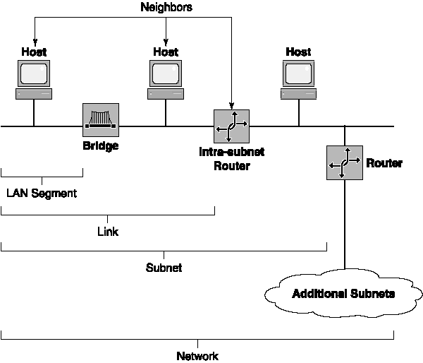
IPv6 terminology

Slide 13
Training course arrangement
Date
Subject
Lecturer
03/10
Introduction to IPv6
Joe Zhao
03/16
IPv6 Addressing
Milo Liu
03/23
IPv6 Header & Extensions
Joe Zhao
03/23
ICMPv6
Feng Zhou
03/30
Neighbor Discovery Protocol
Billy Bian
03/30
Multicast Listener Discovery
Jeffrey Zhou
04/06
Address Autoconfigurator
Feng Zhou
04/06
IPv6 Routing
Milo Liu

Slide 14
Training course arrangement
Date
Subject
Lecturer
04/13
IPv6 Migration Mechanisms
Joe Zhou
04/20
IPv6 Mobility
Milo Liu
Setting Up an IPv6 Test Lab

Slide 15
Appendix
\\fw.zyxel.cn\fileshare\SW2\IPv6
http://www.ipv6ready.org/frames.html
http://www.ipv6ready.org.cn/frames.html

Slide 16
Q & A

